Slide 1

AI-DRIVEN RISK PREDICTION ENGINE FOR EARLY DETECTION OF CHRONIC PATIENT DETERIORATION
Aniruth Narayanan S -22BRS1068
Akil S - 22BRS1088
Jagadeesh Raja N 22BCE1887
Thashventh .G 22BRS1186

Slide 2
1
PROBLEM STATEMENT
Chronic conditions such as diabetes, obesity, and heart failure require continuous monitoring and proactive care. Despite access to vitals, lab results, and medication adherence data, predicting when a patient may deteriorate remains a major challenge. A reliable and explainable AI-driven solution could empower clinicians and care teams to intervene earlier, improve health outcomes, and reduce hospitalization risks.

Slide 3
2
GOAL AND METHODOLOGY
Goal: Predict whether a patient’s health will deteriorate (0/1) based on multiple clinical, lifestyle, and environmental factors.
Consider three chronic diseases: Diabetes, Asthma, Heart Disease.
Reduce individual measurements to time tendencies (use derived features such as slopes, averages, volatility).

Slide 4
3
Dataset Creation
Designed dataset schema with static columns (age, sex, smoking, family history, chronic conditions) and dynamic health metrics (cholesterol, glucose, BP, weight, SpO2, HR, sleep, pollution index).
For each metric, generated statistical trend features:
Latest value
7-day average
Slope (trend ↑/↓)
Volatility (std dev)
Days above/below critical thresholds
Target column: deteriorated_health (0/1).
Created a synthetic dataset (1000 rows) with realistic correlations:
Diabetes → high glucose, higher BMI, more deterioration risk.
Asthma → low SpO2, pollution index, wheezing → deterioration risk.
Heart disease → high BP, cholesterol, chest pain type → deterioration risk.

Slide 5
4
Approach Overview
Data Prep: Cleaned CSV, encoded categorical vars (sex, chest pain, smoker, etc.), scaled numeric features, and split (80/20, stratified).
Modeling: Experimented with XGBoost, RandomForest, GaussianNB, stacking - mediocre improvements.
Final Result: Logistic Regression with class_weight='balanced' - imbalance was addressed and interpretability was achieved.
Explainability: Top 3 contributing risk factors per patient - doctor friendly insights - personalized dashboard based on patient’s chronic health condition.

Slide 6
5
METRICS USED
1. AUROC
2. AUPRC
3. Precision
4. Recall
5. F1-score
6.Accuracy

Slide 7
6
FACTORS THAT DRIVE THIS MODEL
Globally, the model suggests that persistently high or increasing blood pressure, cholesterol, and glucose, together with low oxygenation, disturbances of sleep, and chronic diseases such as diabetes, cardiovascular disease, asthma, and smoking, are the best predictors of decline. These trends reflect population-level risk factors. At the patient level, the model provides explanations in terms of the individual's particular profile for each patient—i.e., one patient's elevated risk is explained virtually solely by rising glucose and labile blood pressure, while another's risk is explained by declining oxygen saturation and sleep. The dual view allows general clinical understanding as well as patient-specific decision making.

Slide 8
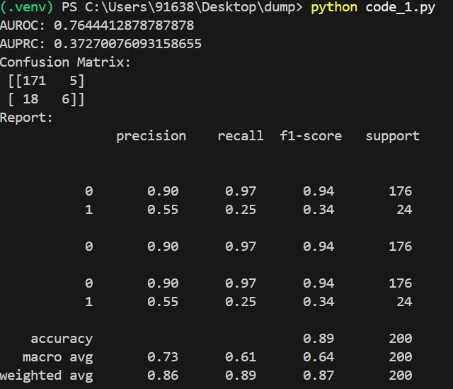
7
Model’s Performance

Slide 9
8
DASHBOARD FEATURES
Probability of deterioration.
Description of both overall trends and patient-level explanations in simple, clinician-friendly language.
Top 3 Risk Factors → patient-specific insights.
Condition Focus:
Diabetes → glucose trends
Asthma → SpO₂, pollution index
Heart disease → BP, cholesterol, chest pain
Trend Visuals → slopes, volatility, thresholds.
Recommendations → lifestyle + medical advice.

Slide 10
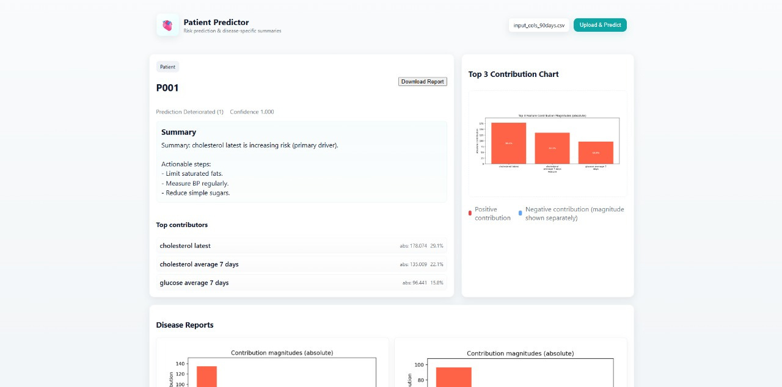
9
SCREENSHOTS OF DASHBOARD PROTOTYPE

Slide 11
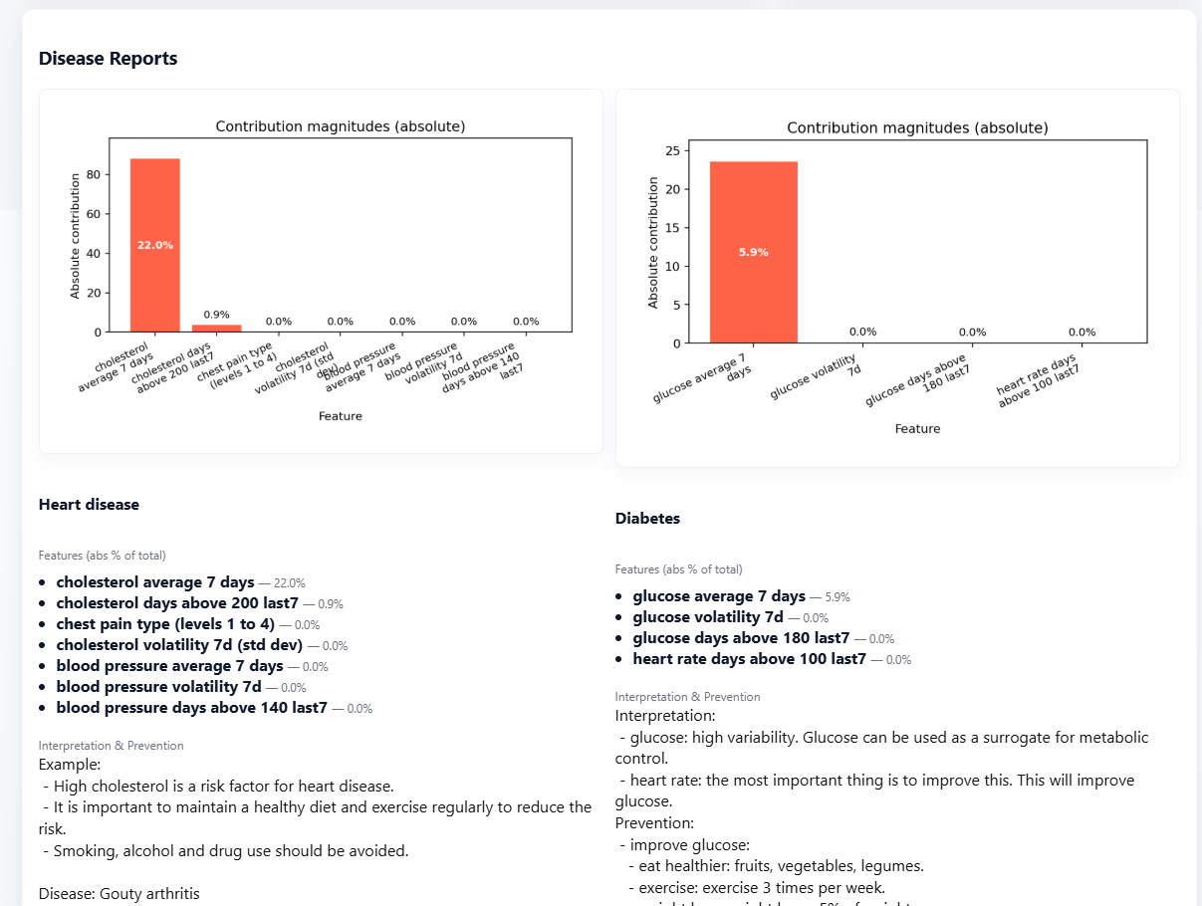
10

Slide 12
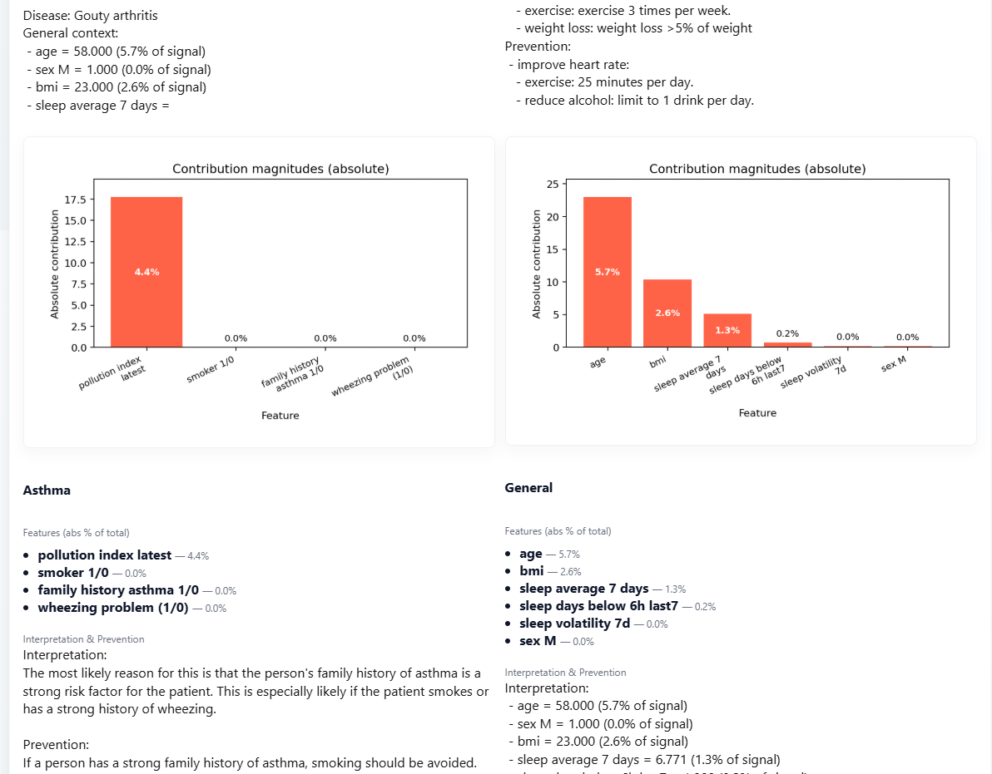
12

